Slide 1
Asian Restaurants in Toronto
Bello Akinwunmi

Slide 2
Introduction
Toronto is the most populous city in Canada
Diverse population of Toronto reflects its current and historical role as an important destination for immigrants to Canada.
Over 200 distinct ethnic groups
Over 160 languages
Multicultural population

Slide 3
Problem
Toronto is an important destination for tourism and immigrants to Canada
High diversity in culture=diverse food choices
From previous analysis: Toronto has many restaurants belonging to different categories such as Asian, American, etc.
Project aim: visualize the locations of Asian Restaurants in Toronto.

Slide 4
Interest
Asian population (immigrants), Asian tourists as well as Torontonians that favor/would like to explore Asian cuisine would be interested in resulting visualization
It should help make residential decisions.

Slide 5
Data Acquisition and Cleaning
Toronto data containing a list of the boroughs, postal codes and neighborhoods was scraped from https://en.wikipedia.org/w/index.php?title=List_of_postal_codes_of_Canada:_M&oldid=890001695
The coordinates for each neighbourhood was obtained from the csv file that has the geographical coordinates of each postal code: http://cocl.us/Geospatial_data.
Using the Foursquare API, all the Asian Restaurants can be explored/retrieved using the Client Secret and Client ID already created.
Postal codes that are not assigned to any neighborhood were dropped.
Boroughs with "Not assigned" neighborhoods: the neighborhoods were made the same as the borough.

Slide 6
Methodology
Various venues in Toronto were explored using the Foursquare API
The number of each Venue Category was retrieved using the count() method.
Asian restaurants were explored with the Foursquare API
Location of the Asian restaurants were visualized on the Toronto map using the folium library

Slide 7
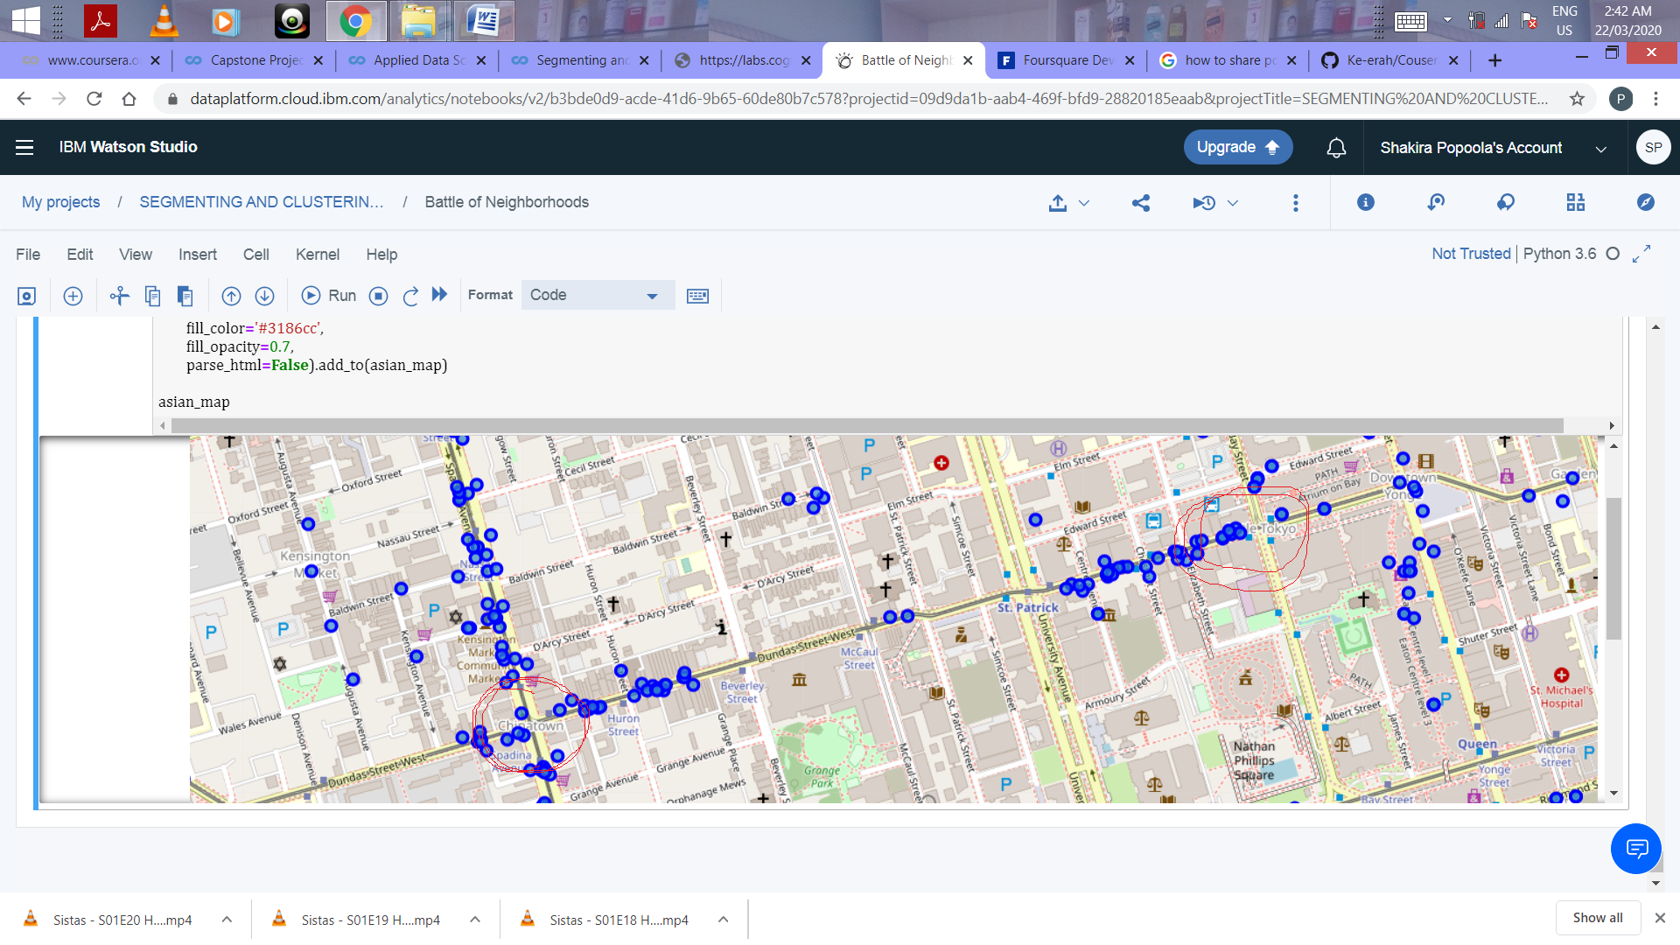
Results 1/2
918 Asian restaurants
Located in 6 boroughs and 72 neighborhoods.

Slide 8
Results 2/2
Top Asian restaurant types include
Japanese restaurant
Chinese restaurant
Indian restaurant, among others.

Slide 9
Discussion 1/5
Asian restaurants are mostly located in 6 boroughs.
Top 3 boroughs: Scarborough, North York and Downtown Toronto.
Other 3 boroughs: East York, East Toronto and Central Toronto

Slide 10
Discussion 2/5
Asian restaurants are especially common in neighborhoods with Asia-related names such as China town, Little Tokyo.

Slide 11
Discussion 3/5
This may suggest that more Asian restaurants are located in areas with high Asian population.

Slide 12
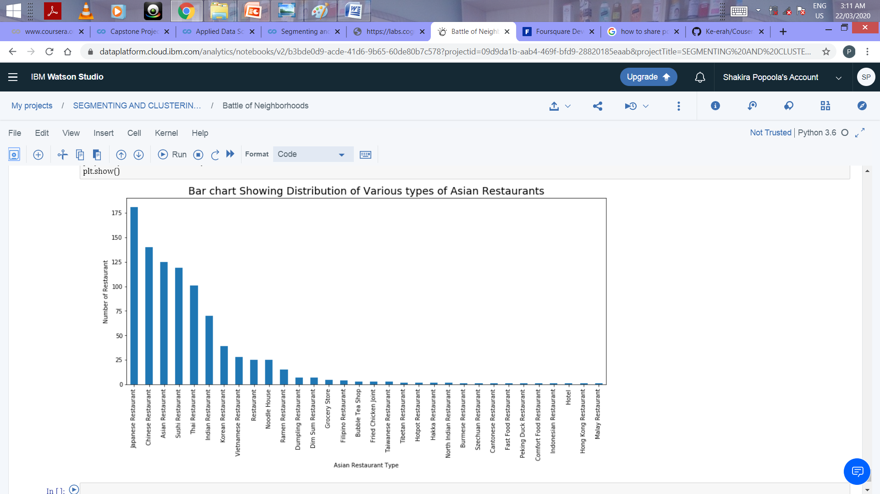
Discussion 4/5
People with different preferences for different Asian meal types can also use the finding as a decision-making tool.

Slide 13
Discussion 5/5
The recommendation that tourists/immigrants interested in having Asian cuisine should reside in any of the 6 boroughs especially the top 3 boroughs.

Slide 14
Conclusion
Asian restaurants are concentrated in three boroughs: Scarborough, North York and Downtown Toronto.
Tourists/immigrants that would like to enjoy Asian cuisine should stay in any of the 6 boroughs

